Slide 1
Univariate Analysis

Slide 2
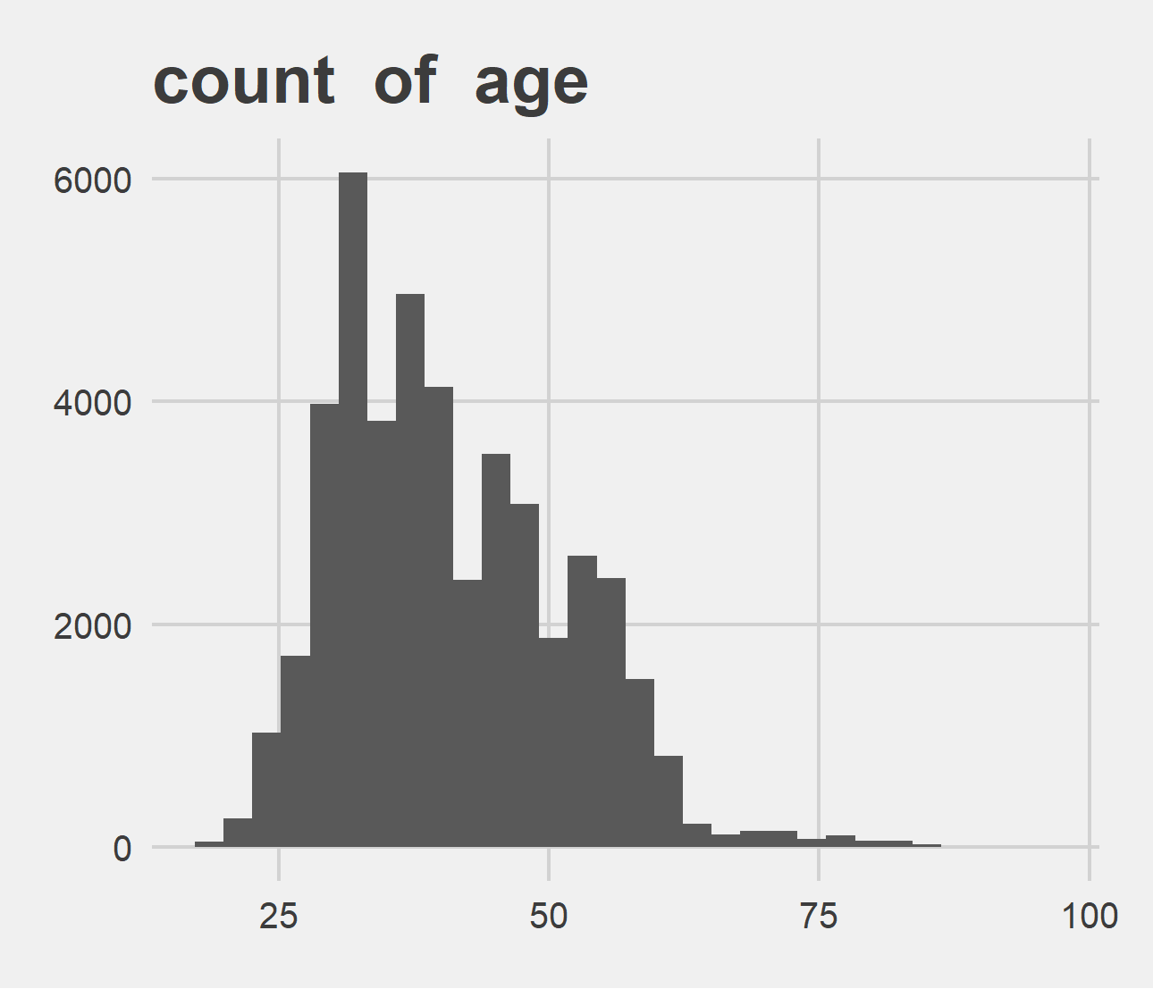
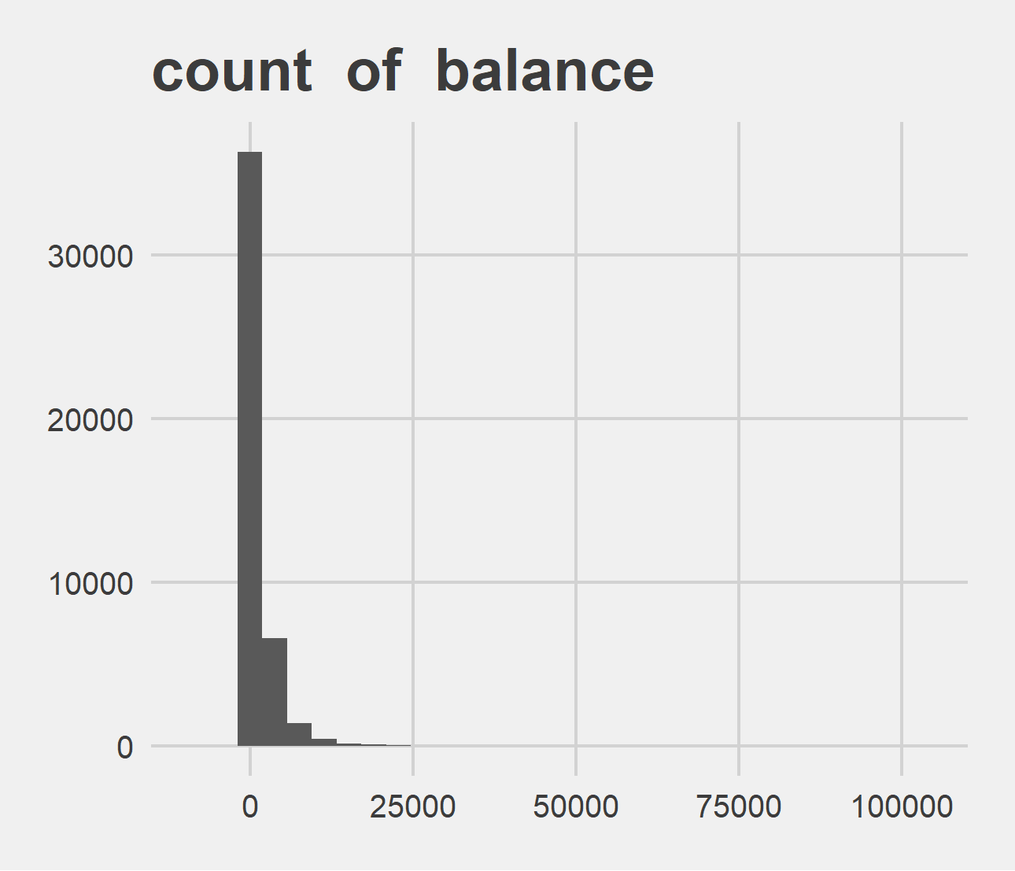
Univariate Analysis Slide 1 of 4
min | 25th | 50th | 75th | max
18 | 33 | 39 | 48 | 95
min | 25th | 50th | 75th | max
-8019 | 72 | 448 | 1428 | 102127

Slide 3
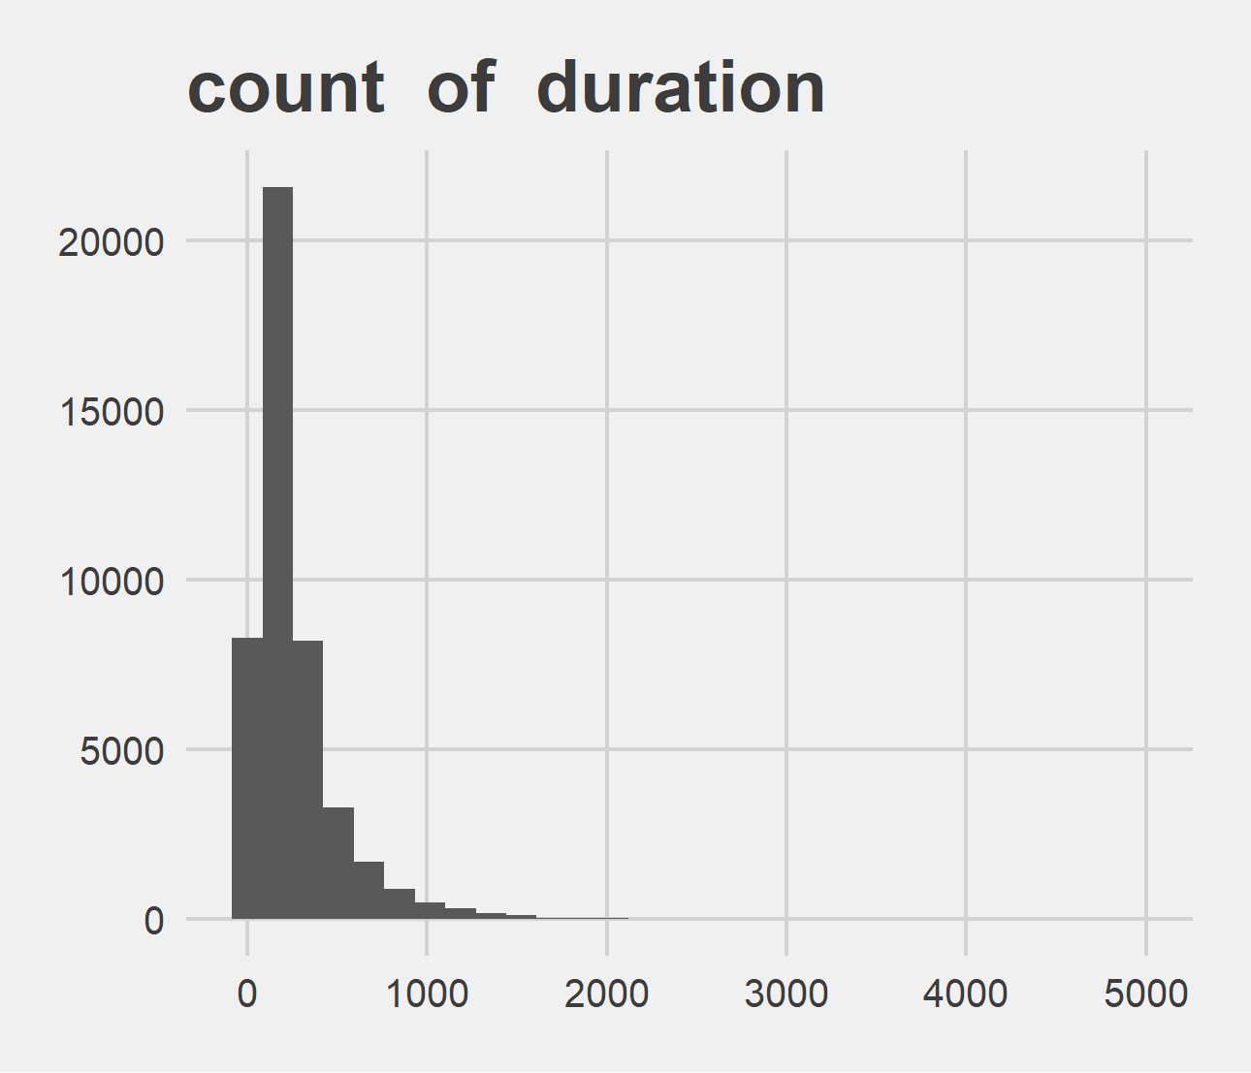
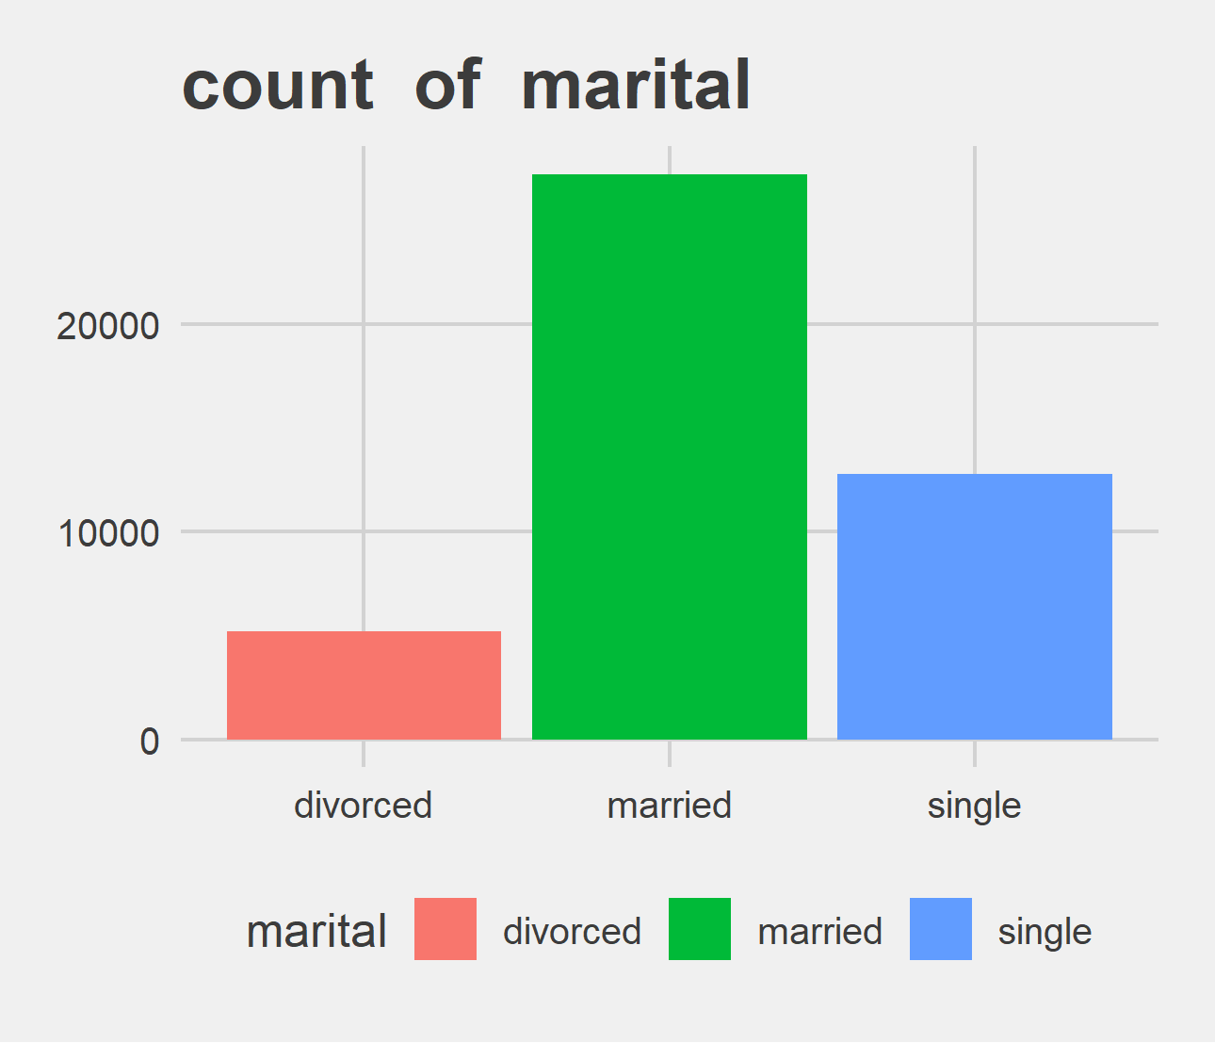
Univariate Analysis Slide 2 of 4
min | 25th | 50th | 75th | max
0 | 103 | 180 | 319 | 4918
Metric | divorced | married | single
Count | 5207 | 27214 | 12790
Perct. | 11.52% | 60.19% | 28.29%

Slide 4
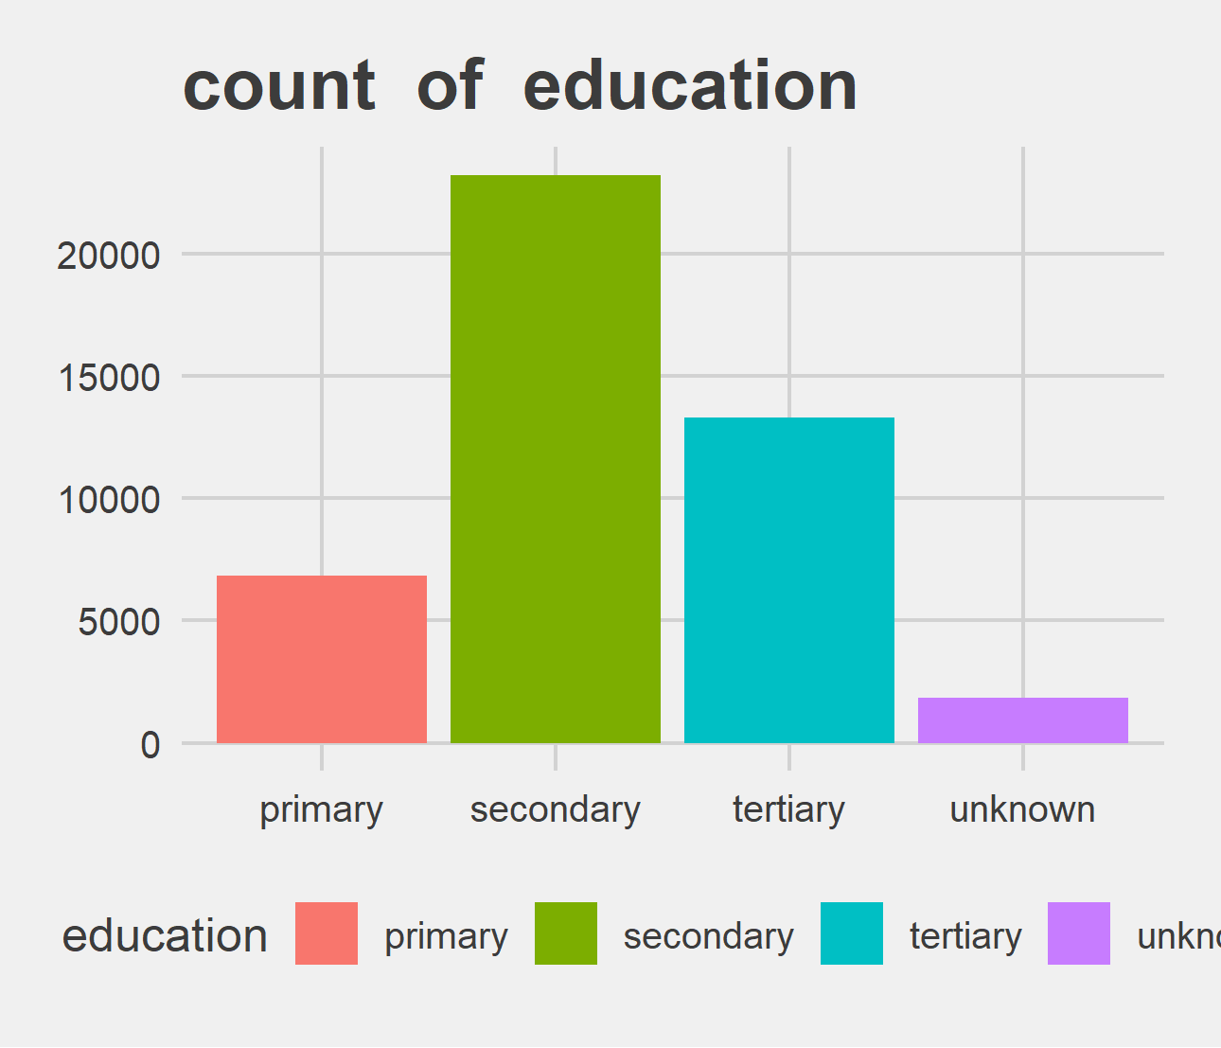
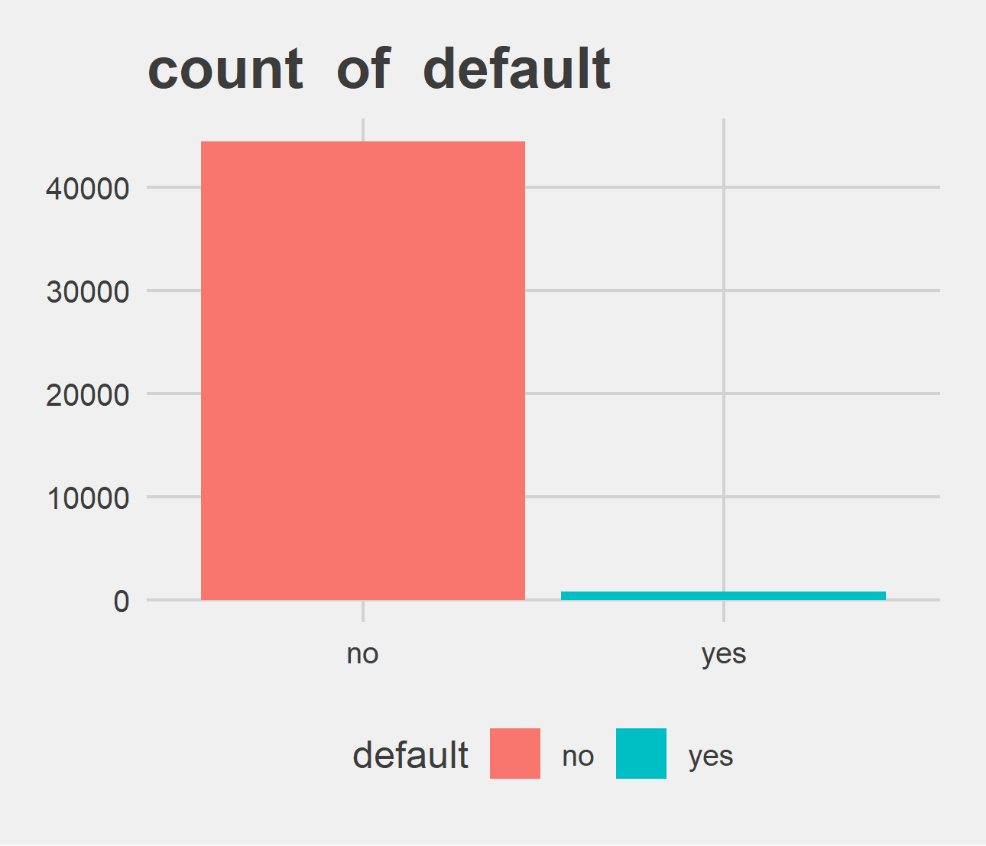
Univariate Analysis Slide 3 of 4
Metric | primary | secondary | tertiary | unknown
Count | 6851 | 23202 | 13301 | 1857
Perct. | 15.15% | 51.32% | 29.42% | 4.11%
Metric | no | yes
Count | 44396 | 815
Perct. | 98.2% | 1.8%

Slide 5
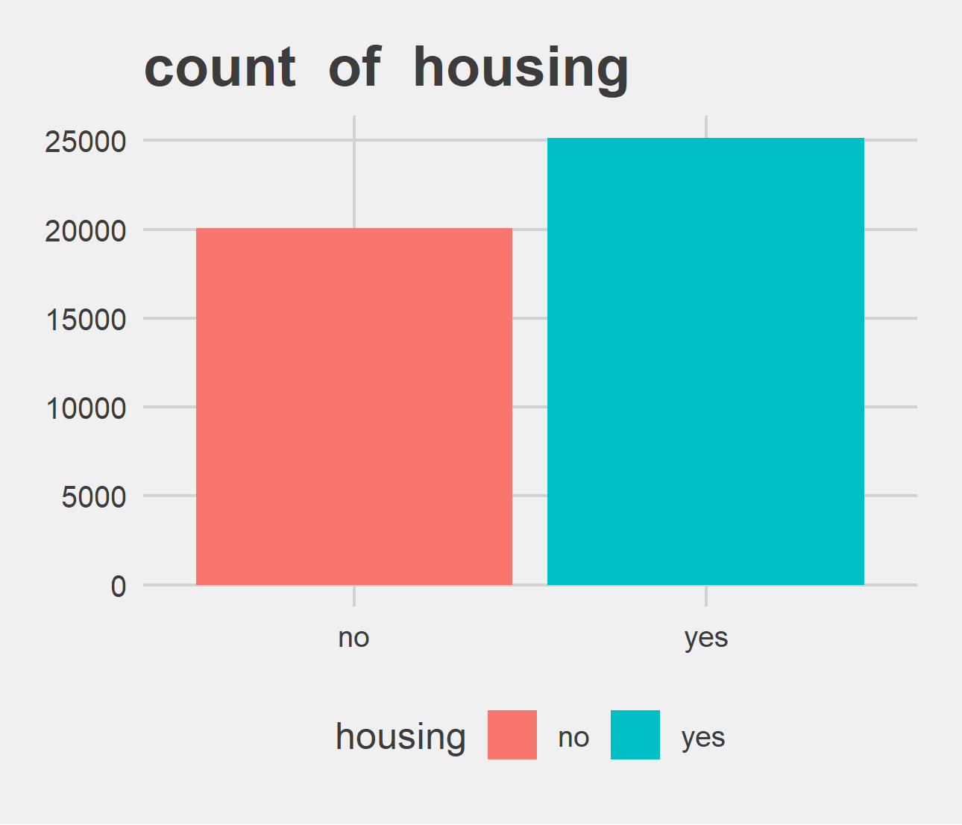
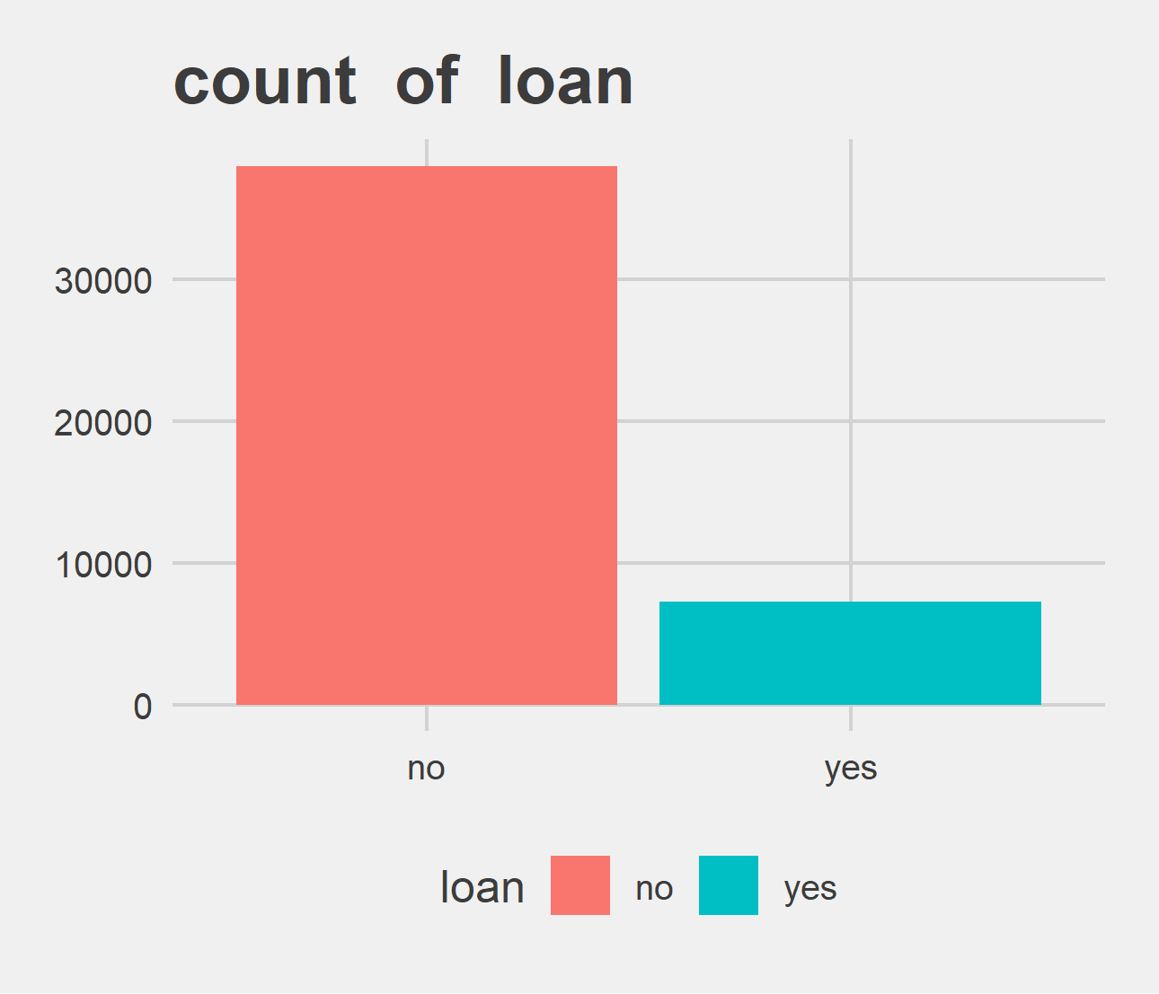
Univariate Analysis Slide 4 of 4
Metric | no | yes
Count | 20081 | 25130
Perct. | 44.42% | 55.58%
Metric | no | yes
Count | 37967 | 7244
Perct. | 83.98% | 16.02%

Slide 6
Bi-variate analysis

Slide 7
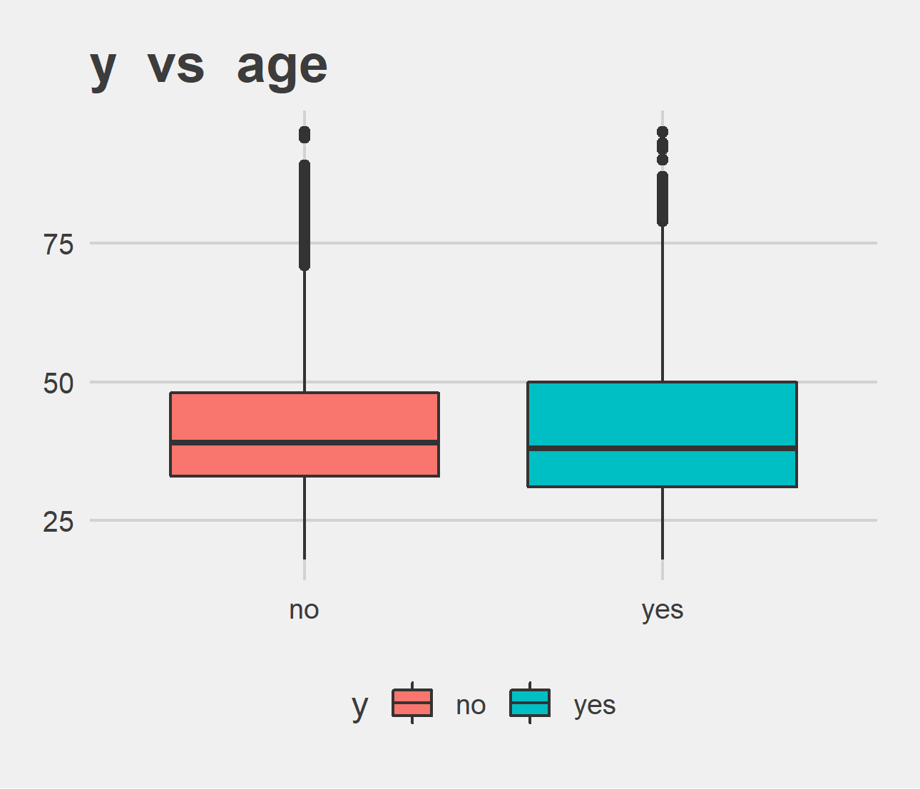
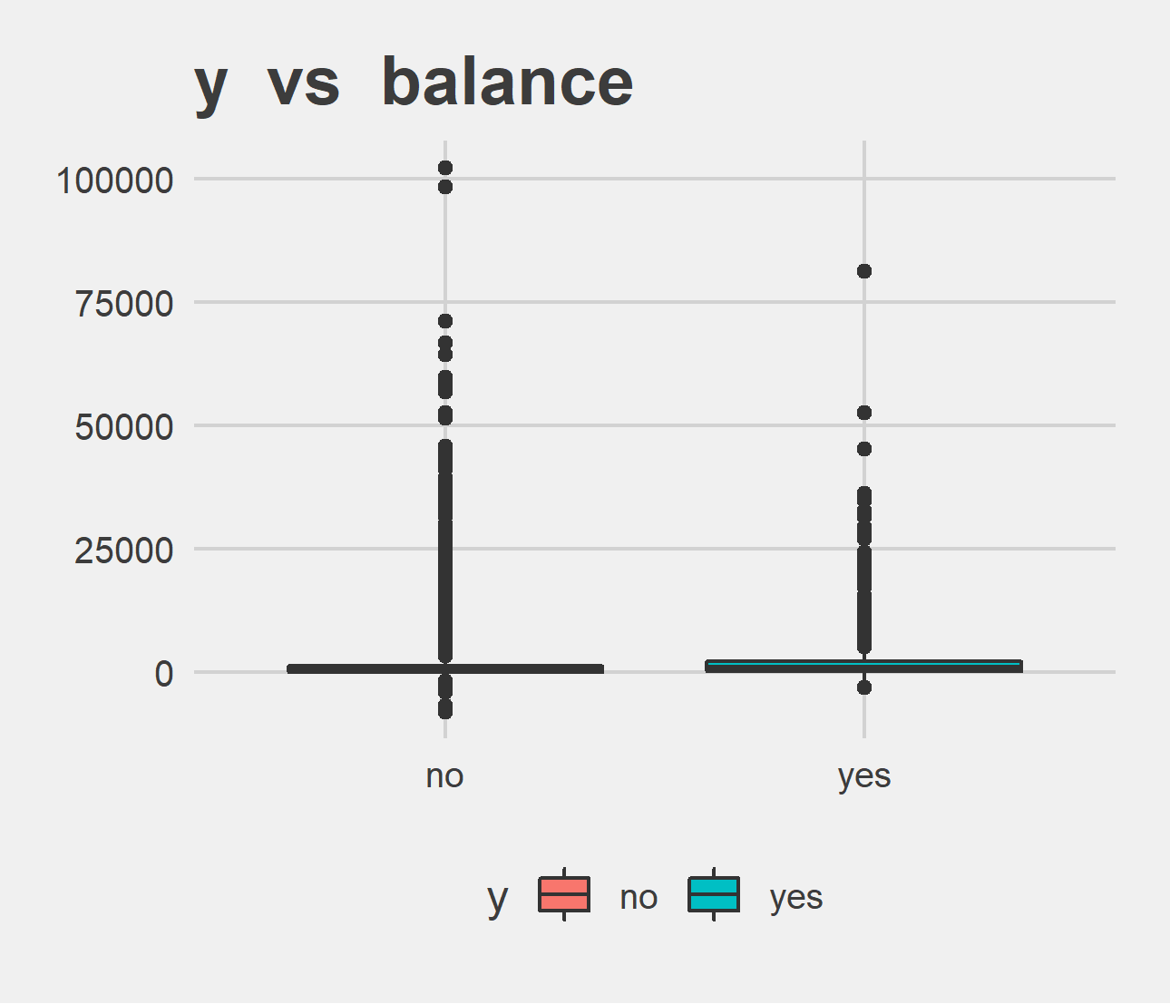
Bi-variate analysis Slide 1 of 4
y | mean - age | median - age
no | 40.84 | 39
yes | 41.67 | 38
y | mean - balance | median - balance
no | 1303.71 | 417
yes | 1804.27 | 733

Slide 8
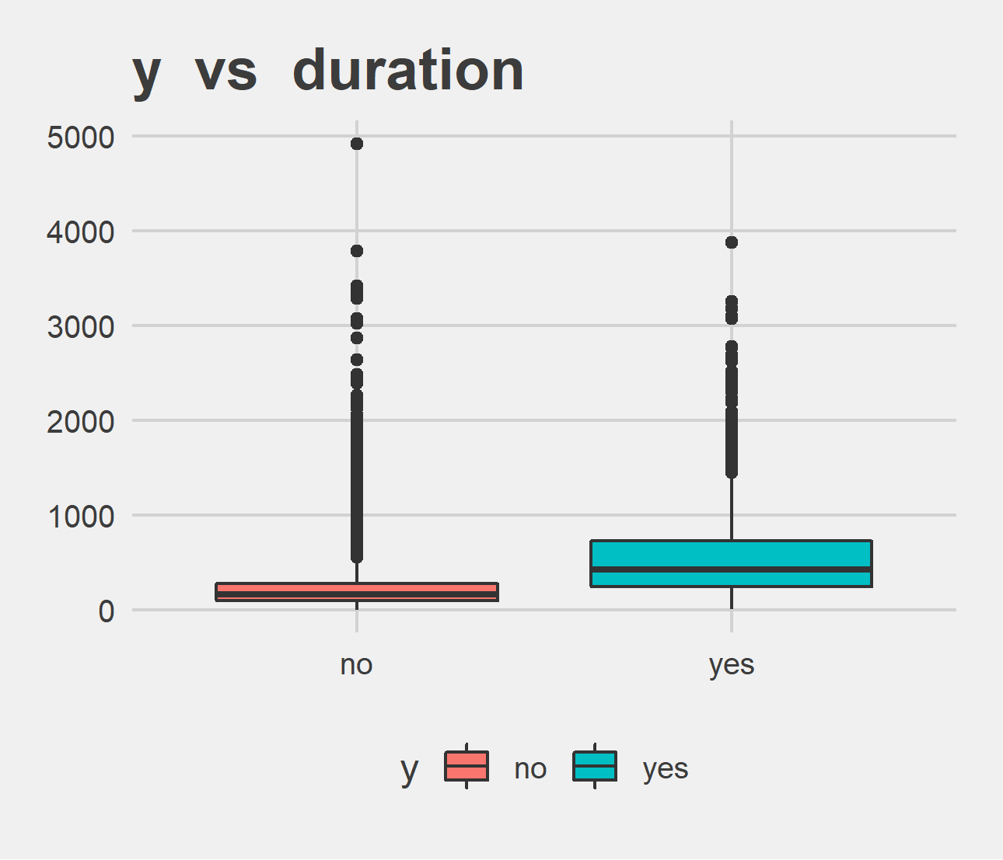
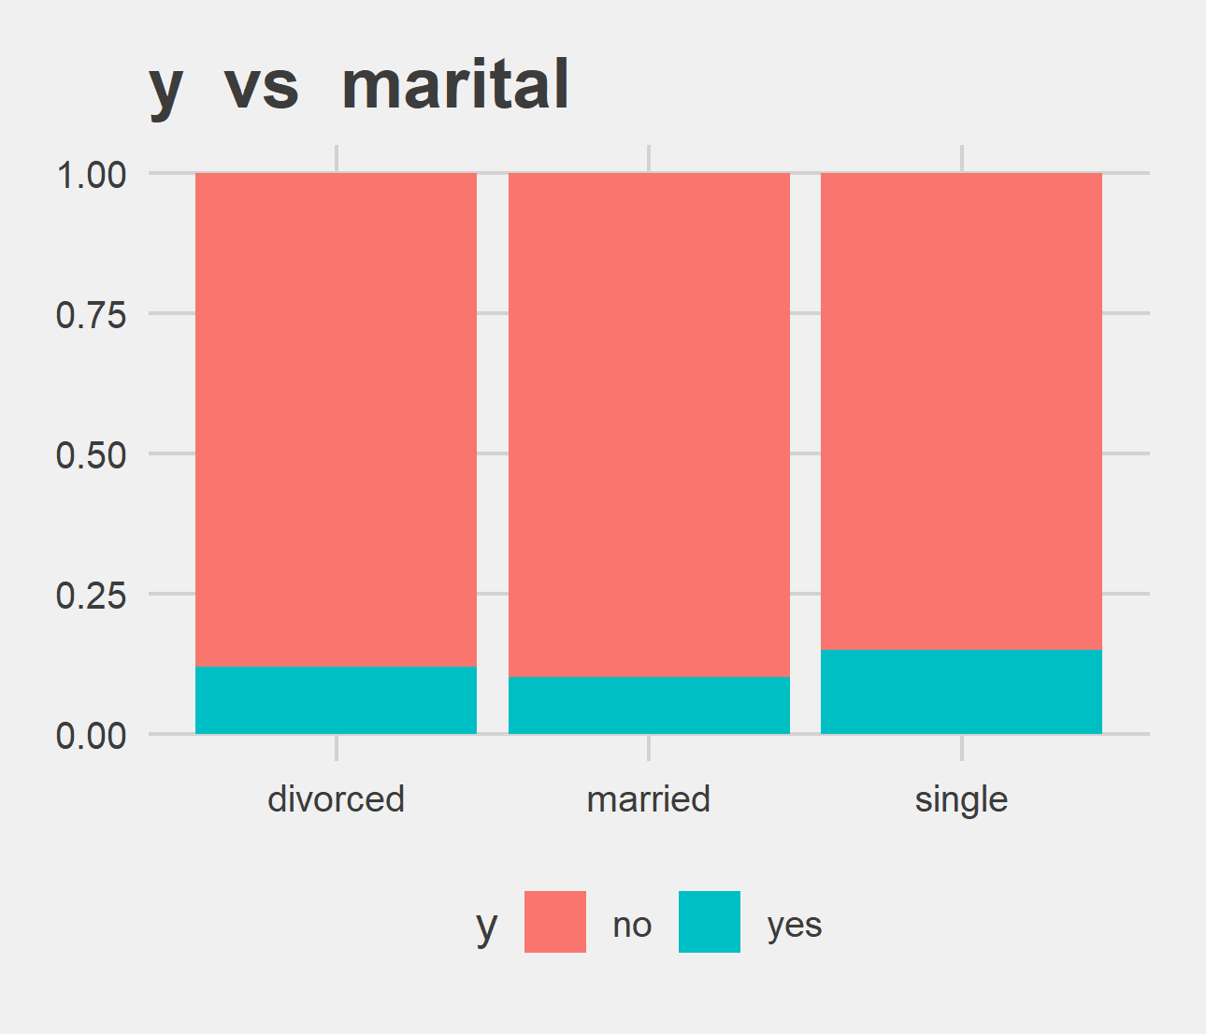
Bi-variate analysis Slide 2 of 4
y | mean - duration | median - duration
no | 221.18 | 164
yes | 537.29 | 426
y | divorced | married | single | divorced | married | single
no | 4585 | 24459 | 10878 | 88.05% | 89.88% | 85.05%
yes | 622 | 2755 | 1912 | 11.95% | 10.12% | 14.95%

Slide 9
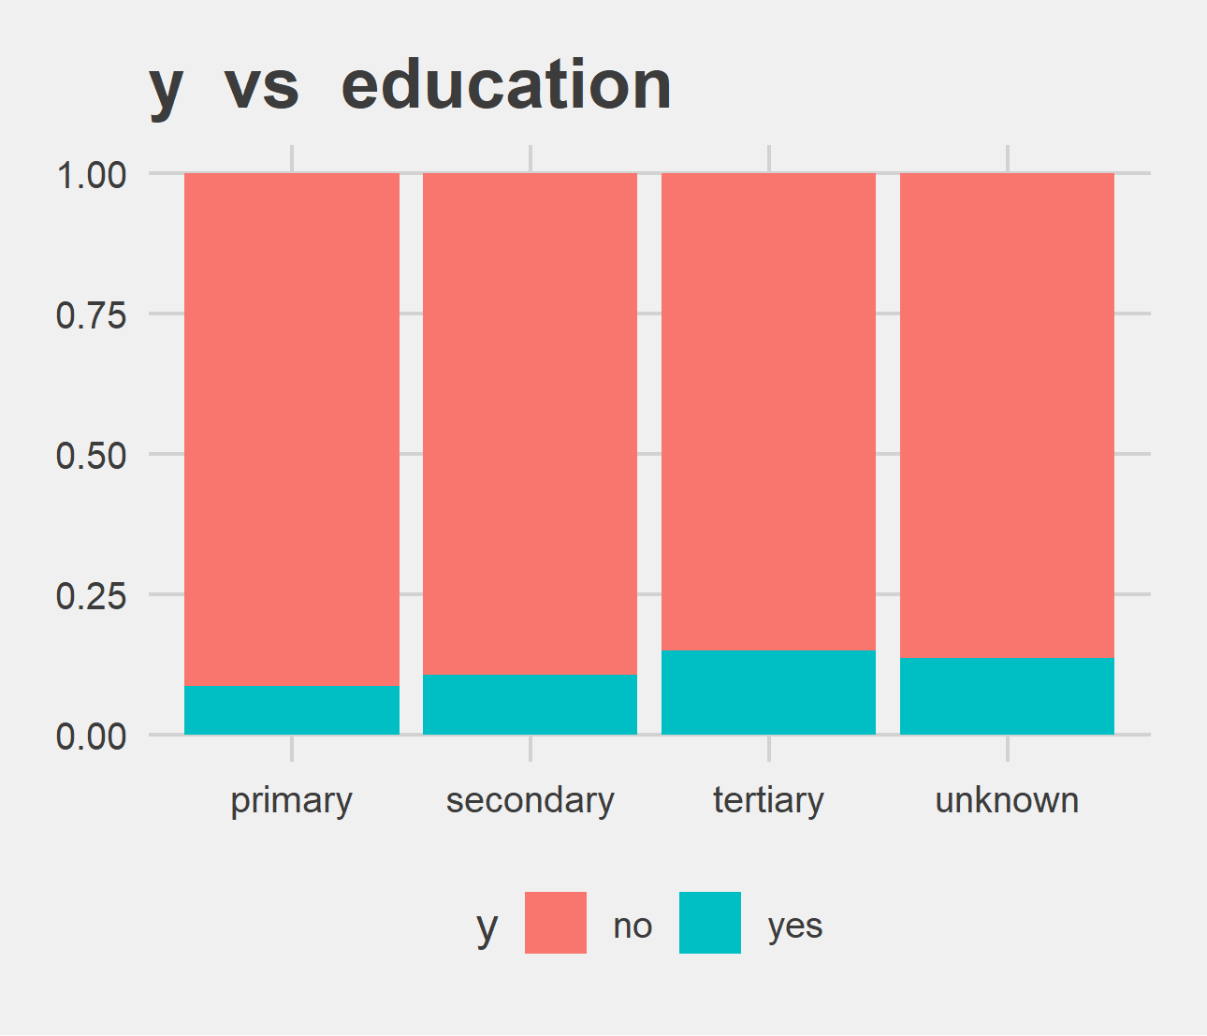
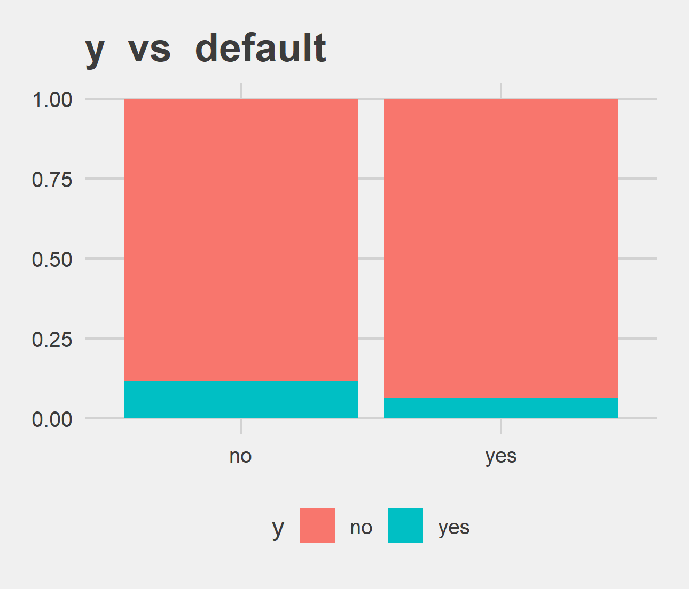
Bi-variate analysis Slide 3 of 4
y | primary | secondary | tertiary | unknown | primary | secondary | tertiary | unknown
no | 6260 | 20752 | 11305 | 1605 | 91.37% | 89.44% | 84.99% | 86.43%
yes | 591 | 2450 | 1996 | 252 | 8.63% | 10.56% | 15.01% | 13.57%
y | no | yes | no | yes
no | 39159 | 763 | 88.2% | 93.62%
yes | 5237 | 52 | 11.8% | 6.38%

Slide 10
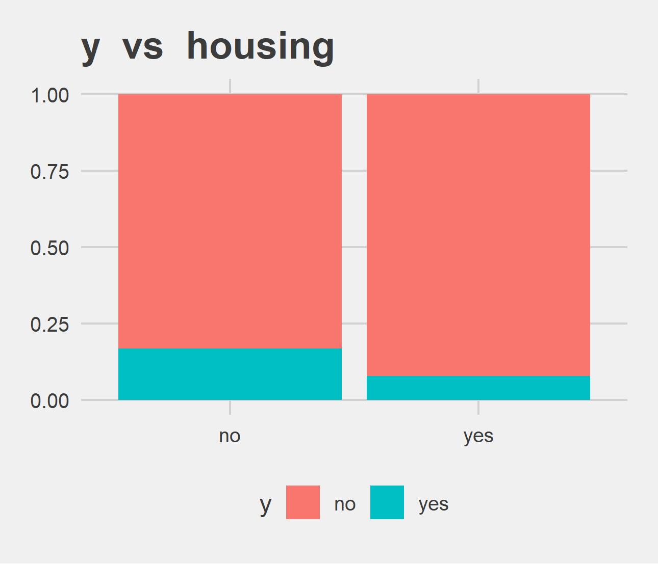
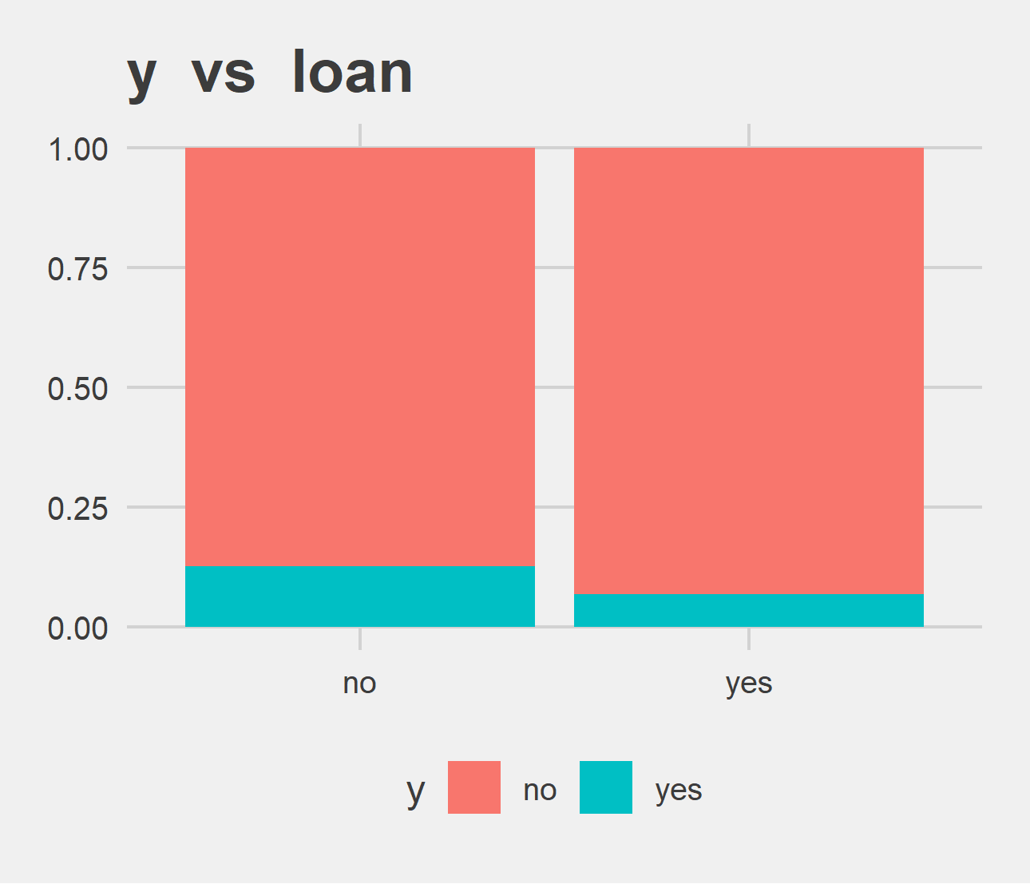
Bi-variate analysis Slide 4 of 4
y | no | yes | no | yes
no | 16727 | 23195 | 83.3% | 92.3%
yes | 3354 | 1935 | 16.7% | 7.7%
y | no | yes | no | yes
no | 33162 | 6760 | 87.34% | 93.32%
yes | 4805 | 484 | 12.66% | 6.68%

